Slide 1

Christopher B. Barrett
Dyson School
Guest Lecture to AEM 2310: Business and Economics of Food
Cornell University
April 27, 2021
Food Security: Combatting Unnecessary Human Suffering

Slide 2

Background
Food security is a human right (Art. 25 1948 UDHR), intrinsic to human flourishing
Food security exists if and only if
“all people at all times have physical, social, and economic access to sufficient, safe and nutritious food that meets their dietary needs and food preferences for an active and healthy life”
(1996 World Food Summit definition, emphasis added)

Slide 3
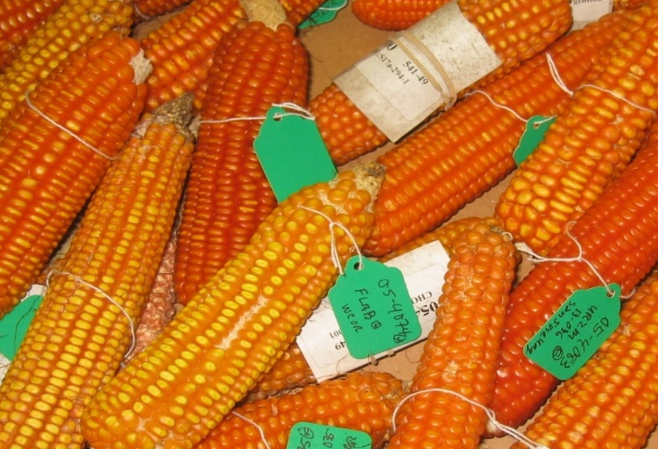

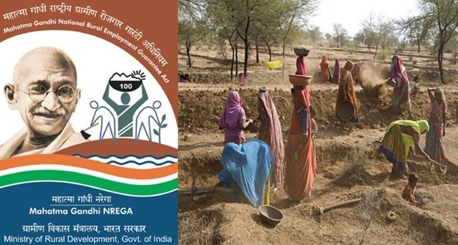
Achieving food security requires technological and policy innovations that are progressive in both senses:
Have faith in science as an engine of advance
Show solidarity with the poor.
Photo credits: Forward Press, Edesia, Mike Gore

Slide 4
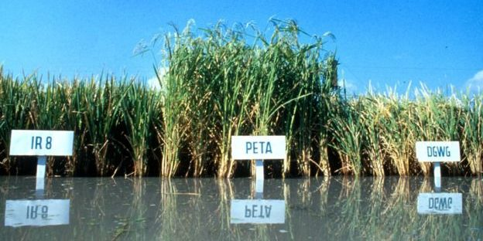
50 yrs ago, facing ‘population bomb’ and famines in Asia/Africa, goal was again reduce hunger/raise yields. Science-led effort to ‘grow the pile of rice on the plates of food-short consumers’. Green Revolution tech successes (Norman Borlaug 1970 NPP!)
Past successes
Photo credit: IRRI

Slide 5

Past successes
“Starvation is the characteristic of some people not having enough food to eat. It is not the characteristic of there being not enough food to eat.” (emphasis in original)
- Opening sentences, Amartya Sen, 1981 Poverty & Famines
Success due to more than just ag R&D, which generates both
losers and winners. Poverty is the key driver of food insecurity.
Policy reforms to address food access have been key to progress:
Right to work and scalable EGS increasingly widespread (e.g., NREGA)
>130 low-/middle-income countries now have at least one non-contributory cash transfer program (Bastagli et al. 2019)
Since March >200 countries launched >1K SP measures! (Gentilini et al.)
~1.5 bn people benefit from gov’t food assistance programs (mostly in-kind) (Alderman et al. 2018)
Improved humanitarian response: EW/targeting, accelerated, cost-effective response. Therapeutic foods. Big shift from “food aid “ to “food assistance”.

Slide 6
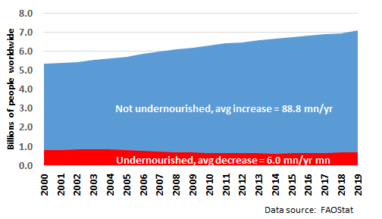
Past successes …
Results:
Global pop grew from 2/3/4 bn in 1928/1960/1975 to 7.8 bn now … but crop yields and dietary energy supplies grew faster.
~5 bn more people get enough Kcal today than 90 yrs ago.
Undernourishment grew ~60mn since 2014, to ~688 mn, but # not under-nourished grew by ~450mn, to 7.1bn.
~90 mn/yr more people met caloric needs since 2000 … more than 10K/hour for 20 yrs!

Slide 7
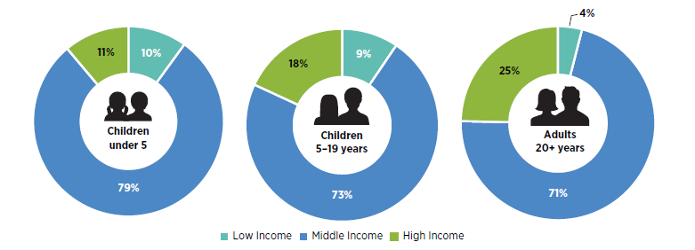
… also fed today’s problems
The focus on starchy staples and calories predictably increased relative price of nutrient-rich foods … esp. compared to ultra-processed foods made w/cheaper sugars/fats, esp. as rising real wages rapidly boost demand for processed foods/FAFH.
Obesity is a global problem, not just (even mainly) a HIC one, with huge health and economic consequences.
Share of world’s overweight/obese population
Source: Shekar and Popkin (2020)

Slide 8
… also fed today’s problems
Micronutrient (i.e., mineral/vitamin) deficiencies can also have serious cognitive/physical effects, can result in nutritional poverty traps.
Globally, among population:
>45% (~25%) of children (everyone) suffers from iron-deficiency anemia
>35% of school age children suffer from iodine deficiency
>30% of children under 5 suffer from vitamin A deficiency
(Beware: MN data are out-of-date and incomplete!)
Source: Barrett and Bevis (2015)

Slide 9
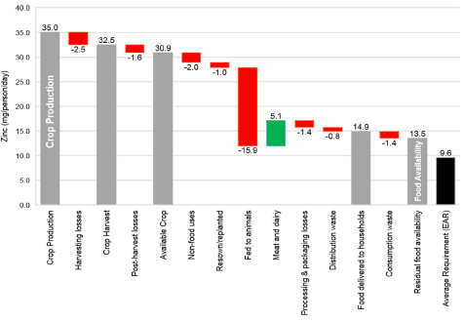
… also fed today’s problems
Cheaper food and longer supply chains increase loss/waste of key nutrients along the value chain from crop production to human consumption
Source: Ritchie et al. 2018 FSFS
For some micronutrients (calcium, folate) residual availability <10% >DRs.

Slide 10
Key lessons
Increasing food/calorie availability is necessary, but not sufficient, to improve food security.
  Improved access is key and depends mainly on poverty reduction and improved social protection measures to ensure that ample healthy food distributed equitably.
  The biggest challenges surround utilization and especially micronutrient deficiencies, which are more widespread and respond more slowly to productivity/ income growth than does macronutrient intake and associated undernutrition.
  So cannot focus just on cereals or even just staples … must pay more attention to healthy, nutrient-dense foods: fruits, nuts, vegetables, lean animal products.

Slide 11
Key lessons
3 bn can’t afford a healthy diet. That is a food systems problem … not just starchy staples issue.
2.5-3.5 bn (?) deficient in ≥1 nutrient, 3-4x #people undernourished.
>2 bn globally are overweight/obese.
By 2030 diet-related health costs reach $1.3 tr (FAO 2020)
~1/5 deaths due to diet/NCDs, w/low (high) intake of whole grains, fruits (sodium) biggest risk factors (GBD, Lancet 2019)

Slide 12
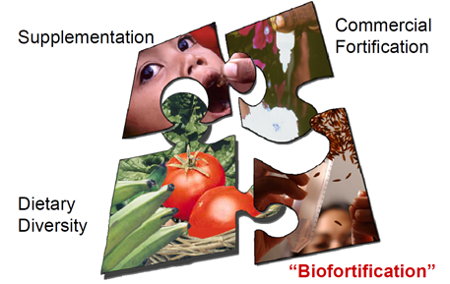
Key lessons
Need innovations throughout food value chain:
- upstream (biofortification, mineral fertilizers/irrigation water)
- midstream (industrial fortification– iodized salt, folic acid)
- downstream (consumer behavior change)
Graphic credit: Ross Welch/Mike Gore

Slide 13
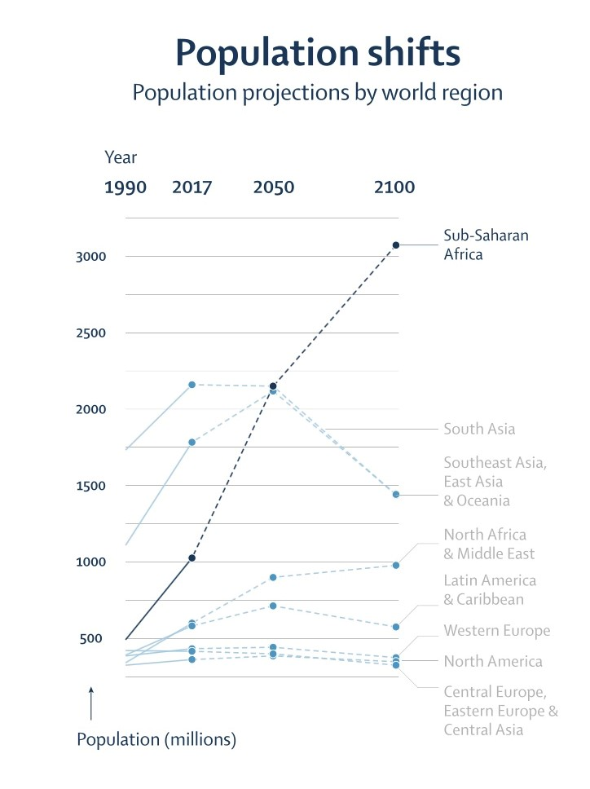
Pay more attention to Africa: >70% global food demand growth to 2100 b/c pop/income growth + urbanization.
Key lessons
GBD (Lancet 2020) population projections:
Global pop will peak ~2064 @ >9.7bn (7.8bn today)
Only Africa growing in 2100, from >1bn today to >3bn
Asia falls from >4 bn today to <3 bn in 2100. ~ All net global pop growth at 2100 will occur in Africa.
Africa also urbanizing fastest, and will grow > world avg.
Income elasticities of food demand highest in Africa.
Must address Africa’s food systems b/c 70-80% of food is consumed within country where feedstock is grown. Trade is essential to stabilize prices. But domestic production/processing systems meet most demand. Must build capacity within Africa to combat food security challenges!
Source: Vollset et al. Lancet 2020

Slide 14
And domestically?
Core problems are similar … too many people cannot afford a healthy diet. This is less an ag problem than a a justice/livelihoods issue, w/health implications.
FI is shockingly widespread in US, esp. for families w/children and for structurally disadvantaged peoples.
Map source: Schanzenbach (2020)

Slide 15
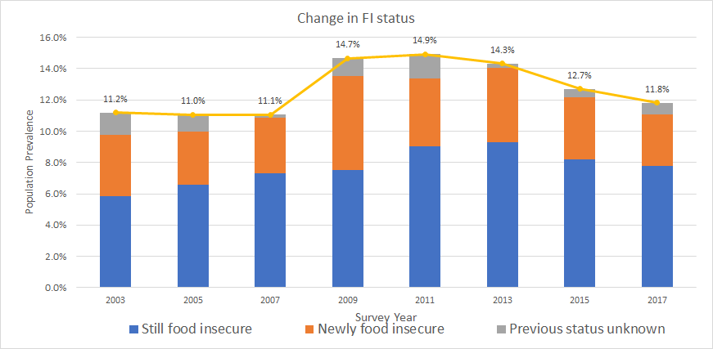
And domestically?
Even w/strong economy there are millions who face food insecurity. #s grow as economy weakens.
In 2019 3.7% reported sometimes/often not enough to eat.
Consistently >10% food insecure
50-70% of food insecure remain FI >2 years straight!
Source: Lee, Barrett & Hoddinott (2021)

Slide 16
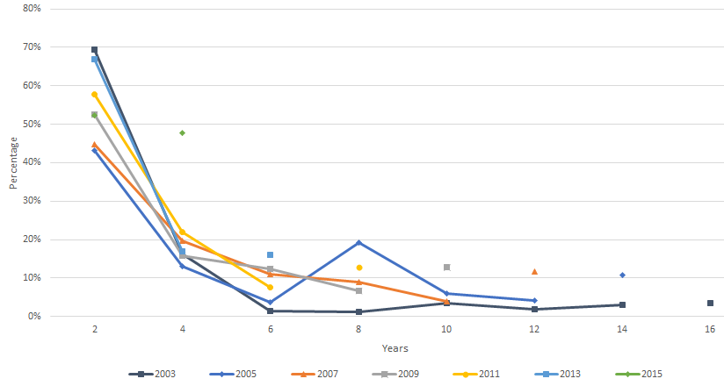
And domestically?
Chronic food insecurity can last very long time
In 2019 3.7% reported sometimes/often not enough to eat.
Consistently >10% food insecure
50-70% of food insecure remain FI >2 years straight!
Source: Lee, Barrett & Hoddinott (2021)

Slide 17
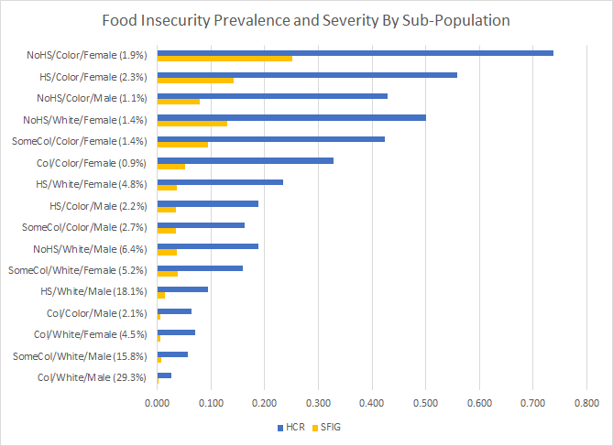
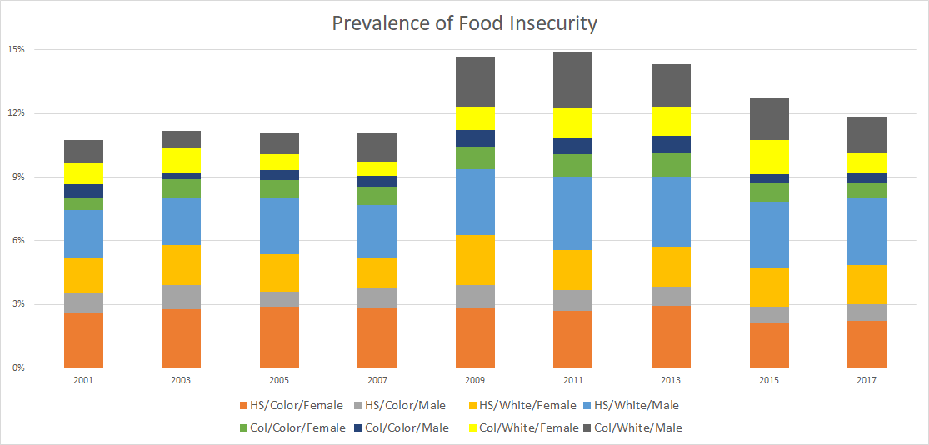
And domestically?
Chronic food insecurity can last very long time
Huge inter-group differences: 28-112x range from HH headed by WOC w/o HS degree vs. by WM college grad
Food security status reflects broader SES differences
Source: Lee, Barrett & Hoddinott (2021)

Slide 18
Summary
Food security remains a systemic challenge, globally and in the US.
Too often thought of as an ag/production problem and/or as a calorie supply or intake issue.
Far more a social justice/poverty problem related to access to healthy foods, w/big health consequences and serious feedback effects on poverty, learning, etc.
Requires a two-pronged progressive approach:
support scientific progress to develop better technologies/ policies
advance a preferential option for the poorest.

Slide 19
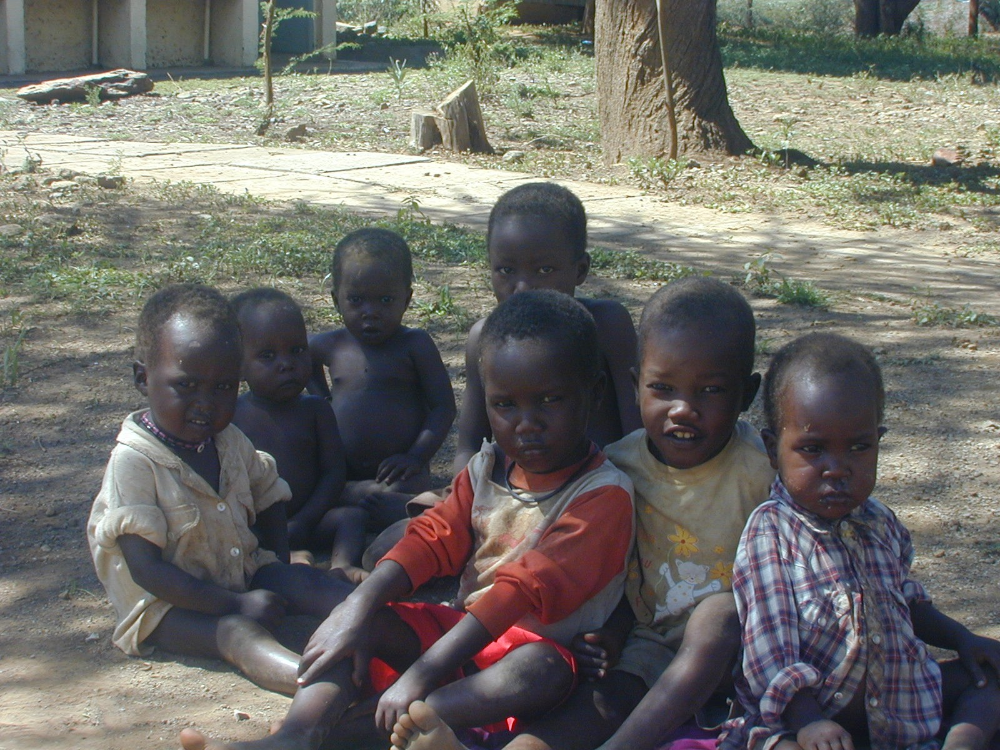
Thank you for your time, interest and comments!

